Slide 1
Swarm Robot
Muhammad Nazhan Bin Ramli
1816847

Slide 2
History of Swarm Robot
The term ’swarm’ in the context of robotics is applied for the first time by G. Beni [8] and Fukuda [9] in 1988. According to G. Beni, cellular robotics is a system composed of autonomous robots, that operate in a n-dimensional cellular space, without any central entity. Additionally, they havelimited communication among themselves, and they coordinate and cooperate to accomplish common goals. On the other hand, Fokuda uses swarm as a group of robots that can work together like the cells of a human body and as a result, they can accomplish complex goals. One year later G. Beni and J. Wang introduces the term of swarm intelligence in relation to cellar robotic systems . They claimed that cellular robotic systems are able to show ’intelligent’ behavior via coordinating their actions.
In 1993, C. Ronald Kube and Hong Zohng [11] constructed a multi-robot system that was inspired by the collective behaviours of natural swarms. At the same year, Gregory Dudek define swarm robotics with respect to different features, including the size of a swarm, communication range amongst the robots in a swarm, communication topology, communication bandwidth, reorganisation rate of a swarm,abilities of swarm members and swarm homo- or heterogeneity. According to the authors ’swarm’ is a synonym to multirobotic systems, which is why it was still not clear what properties differ the term ’swarm robotics’ from other robotic systems.

Slide 3
However, in 2004 G. Beni [21] made another attempt to describe a swarm more precisely. According to him the robots in a swarm are simple, identical and self-organizing, and the system must be scalable, and only local communication is available amongst swarm members. These are the properties that are still considered as the basics of defining and distinguishing swarm robotic systems from other robotic systems. The robots used for the experimentation had a lot in common to social insects, for example the simplicity and the decentralization of the system. As a result, the word ’swarm’ was used instead. In the same time period, another research work [22] also dealt with the topic of swarm robotics. The author defined swarm robotics as ” Swarm robotics is the study of how large number of relatively simple physically embodied agents can be designed such that a desired collective behavior emerges from the local interactions among agents and between the agents and the environment”. He made some additions to the basic properties of a swarm robotic system. According to him, the robots must be autonomous, that means they should be able to interact with their environment and make decisions accordingly. Secondly, the swarms should consist of a small number of homogeneous groups, and each group should have a large number of robots in it.
Further, it is still not clear what size a swarm can or should be. G. Beni gives a brief definition to the size of a swarm as ”It was not as large as to be dealt with statistical averages, not as small as to be dealt with as a few-body problem” . According to the author the size of a swarm should be in the order of 102 􀀀 10<<23. This means the number of members is greater than 100 and much less than 1023. The size also depends on the type of swarm robotic systems. If systems are for example, heterogeneous that involves robots with extra powers, then most probably the swarm size is not that big. This is due to the reason that the powerful robots can perform most parts of the task. On the other hand, a system that has very simple robots that cannot perform any significant task at their own, could have a huge size of swarm.

Slide 4
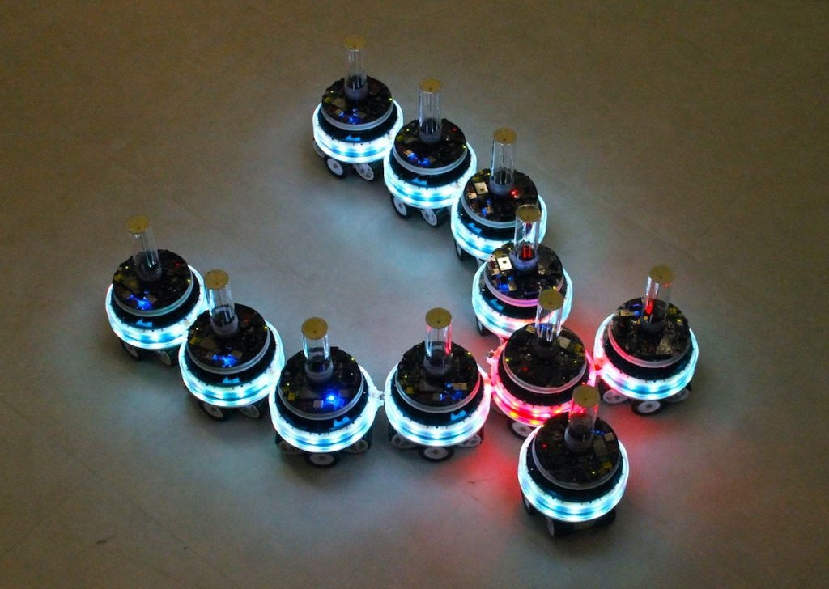
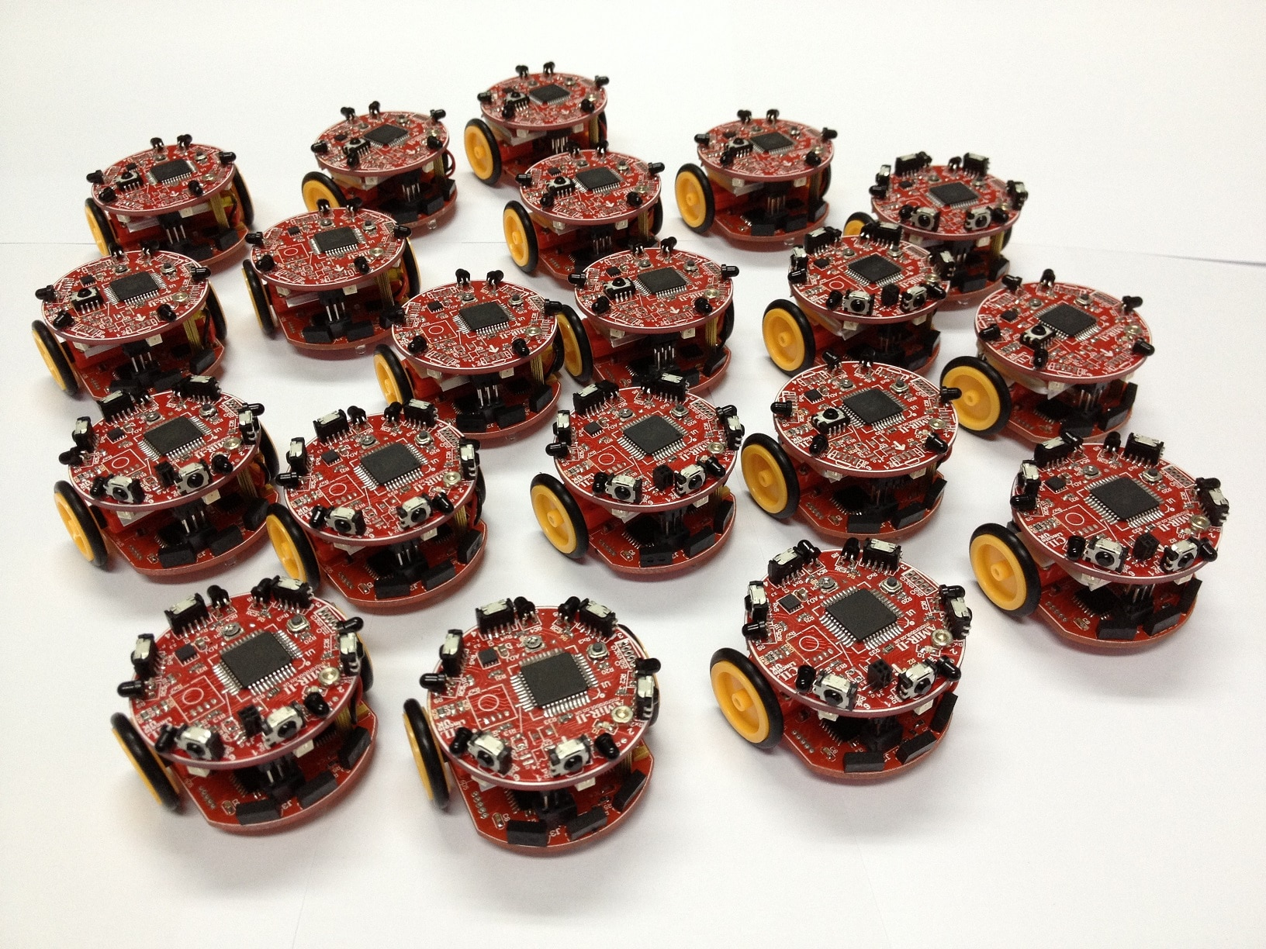
Researchers and developers aim to build robotic systems, known as swarm robotic systems, consisting of large number of simple autonomous robots, that coordinate and cooperate, just like natural swarms, to attain simple to very complex tasks. The coordination and cooperation is gained via very simple rules. Swarm robotics is the study of how to make the coordination and cooperation in large group of robots, possible. It deals with the realization of these swarming properties that are inspired from natural swarms, in the field of robotics

Slide 5
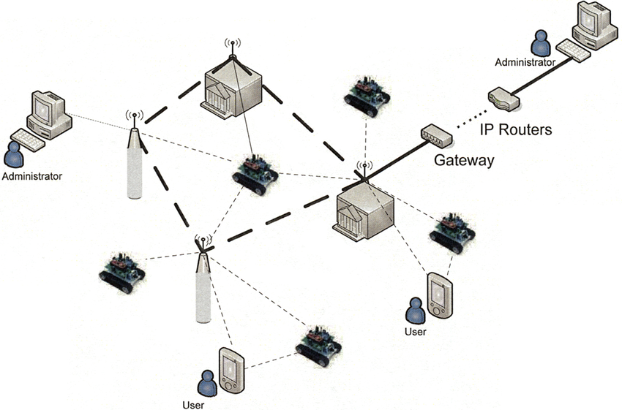
Basic System Architecture

Slide 6
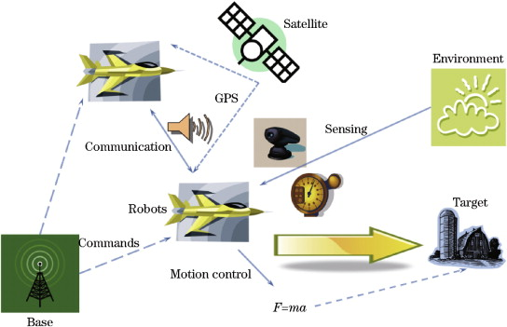

Slide 7
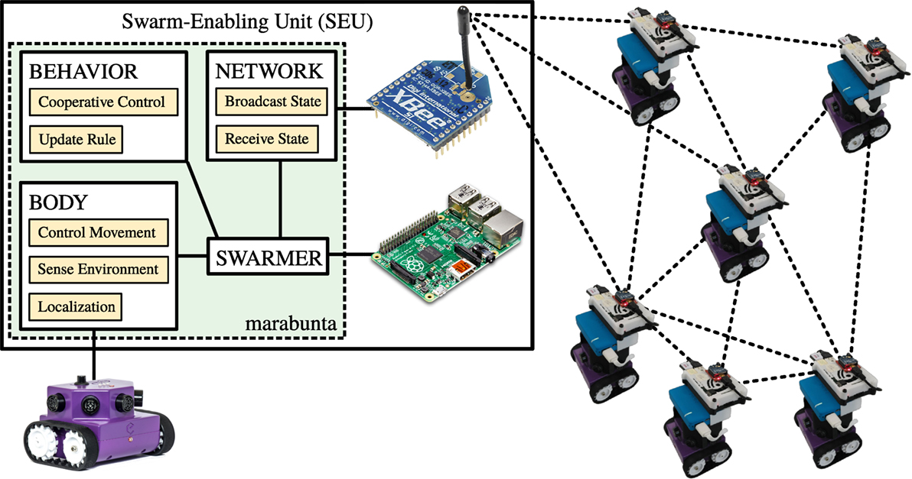

Slide 8
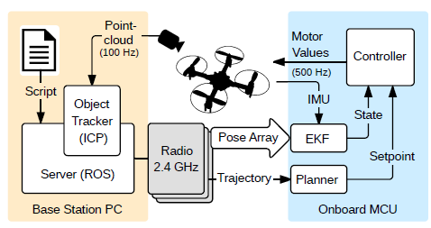

Slide 9
ROBOT DESIGN VS TASKS

Slide 10
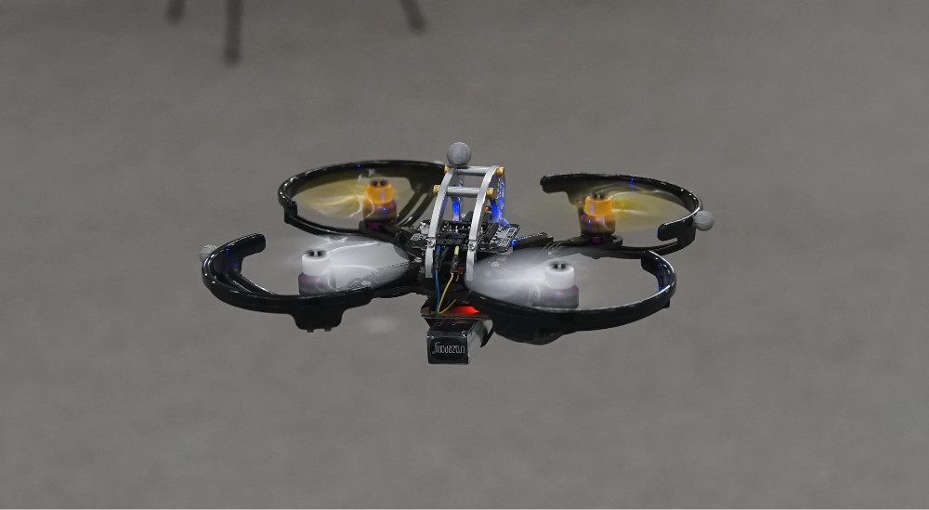
Crazy Swarm Robot
Crazyswarm is a swarm of 49 Crazyflie 2.0 nano-quadcopters operating in a new experimental robotics building at USC. The developers localize the quadcopters with a Vicon motion-capture system and a custom object tracker that supports identical marker arrangements. Three shared radios broadcast position updates at 100Hz and send high-level trajectory commands to each vehicle. Vicon-IMU sensor fusion, trajectory evaluation, and position control are all performed onboard at 500Hz.
Medium Quadrotor

Slide 11
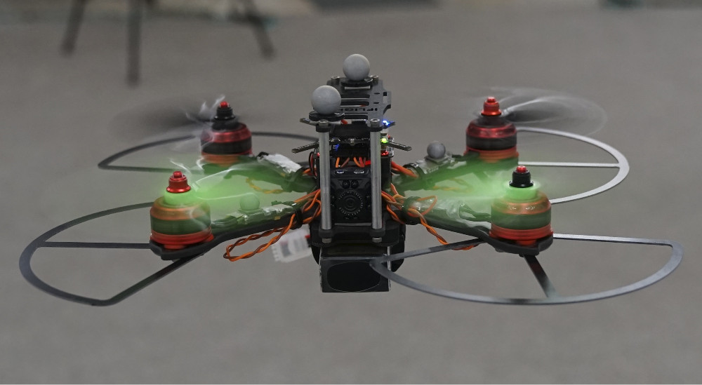
Large Quadrotor

Slide 12


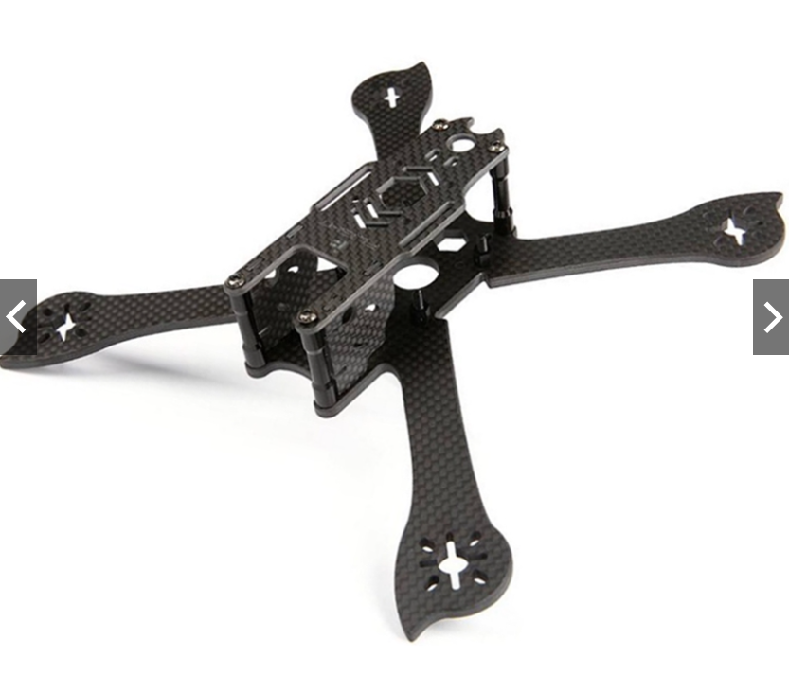
Frame
iX5 V3 X Hybrid FPV Racing Frame is the latest version of IFlight iX5 Series Frame Kit. Bottom carbon fiber plate and arms of iX5 are combined into one complete 4mm 100% pure carbon fiber and specially designed to be Squish X Hybrid shape, which makes it strong and anti-shock. There's no need to do tedious assembling arms job anymore. Besides, the X shape helps to increase the computational efficiency of the flight control and makes flight more nimble; The super light weight design helps decreasing the weight while ensuring the iX5 is strong enough. What's more, the motor mount on the arm has been strengthening to protecting the motor from crashing.

Slide 13
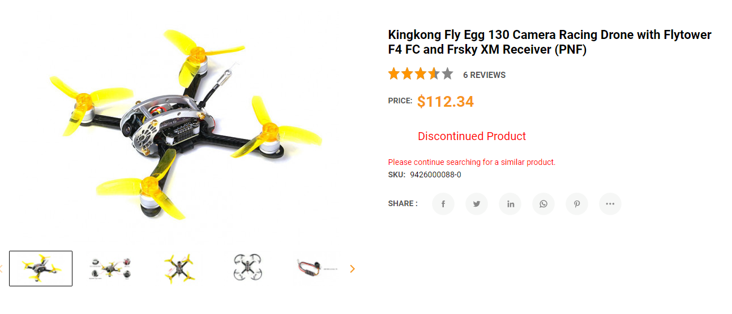
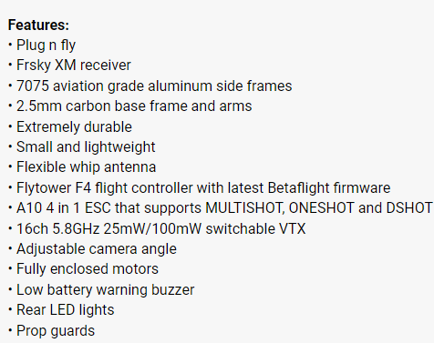
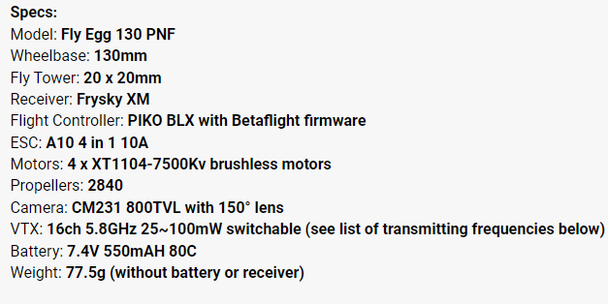
Frame with Propeller Guard

Slide 14


Propeller Guard

Slide 15
ACTUATORS & LOCOMOTIONS

Slide 16

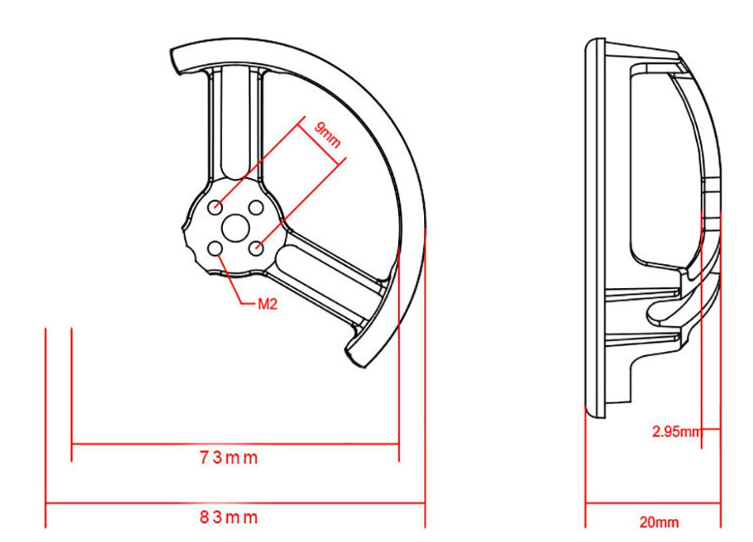

1) Propellers

Slide 17


Slide 18

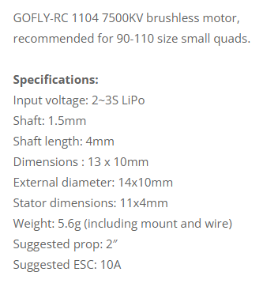
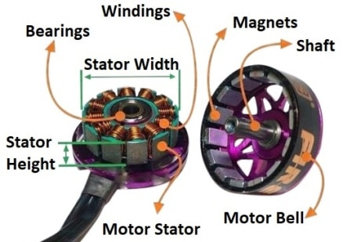
2) Drone Motors

Slide 19



Slide 20
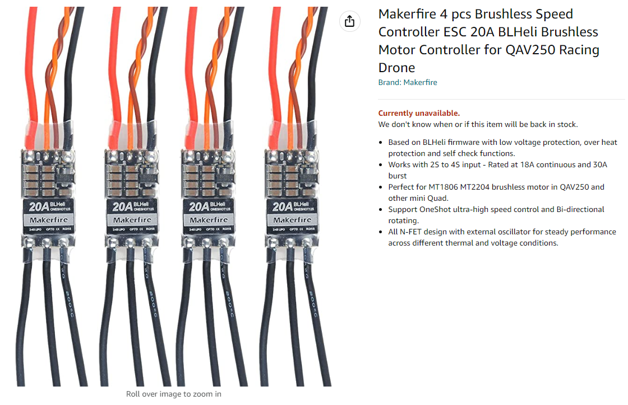
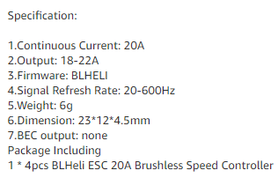

3) Motor Controller

Slide 21
NAVIGATION SYSTEM & CONTROLLER

Slide 22
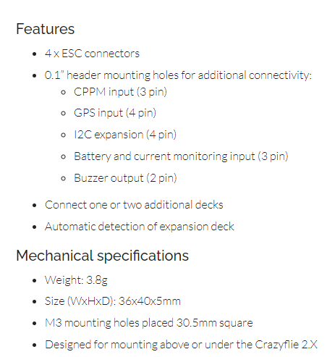
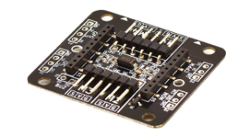
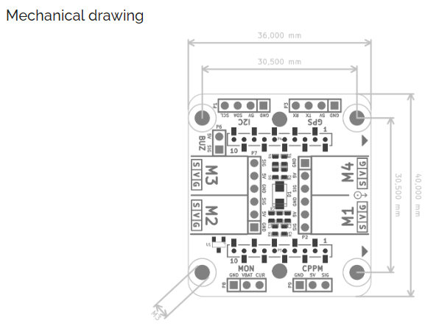
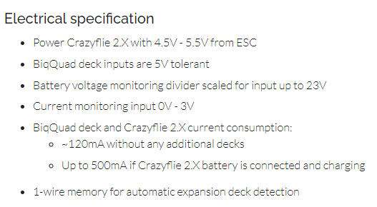
Flight Controller
With the BigQuad deck you can transform your Crazyflie 2.X to a bigger quad by connecting external Electronic speed controllers (ESCs) to the breakout connectors on the deck. The autodetection of the deck makes this transformation possible to do in seconds. The deck also contains breakout header connectors for additional accessories such as external receiver (CPPM input) and GPS. It can also monitor battery voltage and current.
Bitcraze BigQuad Deck

Slide 23
DATA COLLECTION

Slide 24


Camera

Slide 25
DATA TRANSMISSION

Slide 26
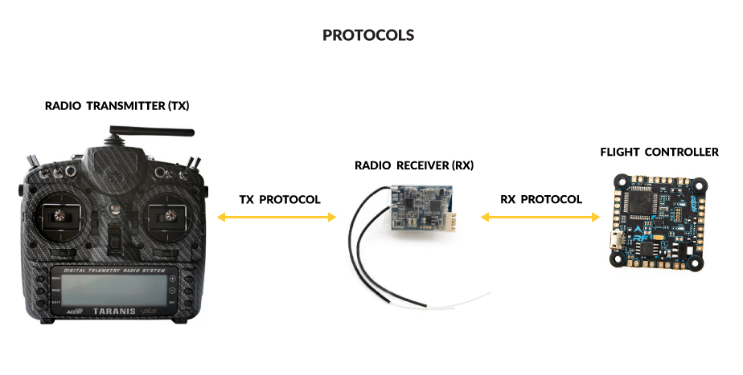
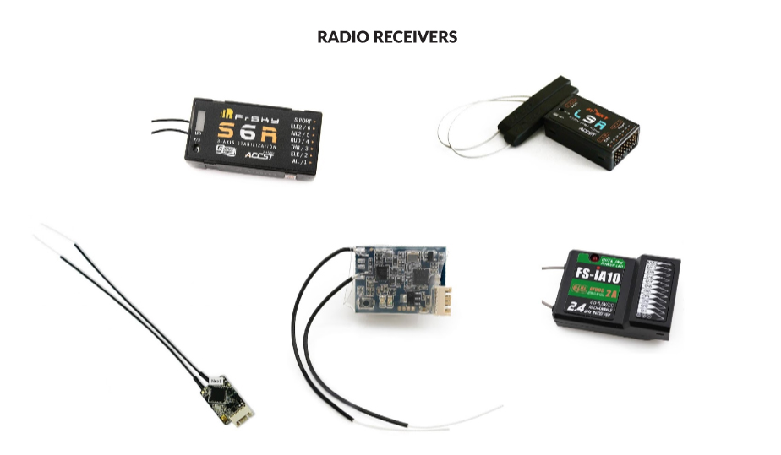
1) Radio protocols
To remotely control the drone

Slide 27

2) Wireless connectivity

Slide 28
POWER SYSTEM MANAGEMENT

Slide 29
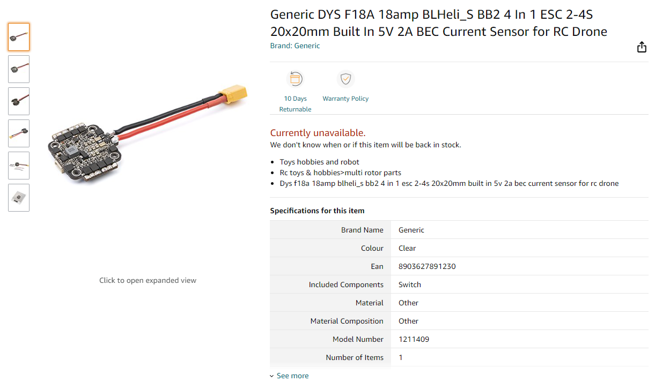

1) Electronic Stability Control (ESC)
WB37 Intelligent battery for remote control

Slide 30

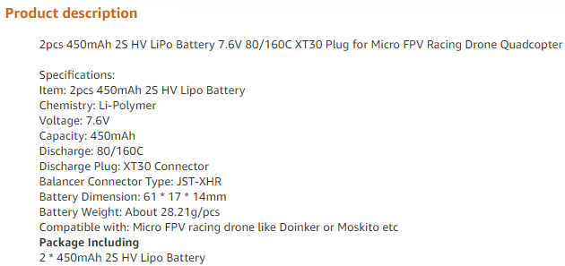
2) LiPo Battery

Slide 31



Slide 32
Link
https://crazyswarm.readthedocs.io/en/latest/hardware.html#components

